Slide 1

ENGINEERING DESIGN PROJECT -
“ HOME AUTOMATION TO PREVENT THE SPREAD OF COVID-19 “
DEPARTMENT OF
ELECTRONICS AND COMMUNICATION SEMISTER-II
SECTION ‘C2’

Slide 2
ACKNOWLEDGEMENT
It gives us immense pleasure, to express our sincere gratitude to the management of M S Ramaiah Institute of Technology, Bengaluru for providing the opportunity and resources to accomplish our project work in their premises.
On the path of learning, the presence of an experienced guide is indispensable and we would like to thank our guides Veena G N, Assistant Professor and Chitra M, Assistant Professor from department of ECE, for their invaluable help and guidance.
We would also like to thank the staff of Department of Electronics and Communication Engineering for their co- operation and suggestions. Finally, we would like to thank all our friends for their help and suggestions without which completing this project would not have been possible
Obediently,
S N CHARAN;
MUKESH H P;
MOULESWAR;
PRAJWAL J;

Slide 3
CONTENTS :
INTRODUCTION
HISTORY OF AUTOMATION
OBJECTIVES
WORKING OF AUTOMATIC DOOR
COMPNENTS AND SUPPLIES
CODE FOR AUTOMATIC DOOR
HARDWARE CONNECTIONS
HOME LIGHT AUTOMATION WORKING
HARDWARE SUPPLIES
HARDWARE CONNECTIONS
SCOPE AND CONCLUSION

Slide 4
INTRODUCTION
While the cost of living is going up, there is a growing focus to involve technology to lower those prices. With this in mind the Smart Home project allows the user to build and maintain a house that is smart enough to keep energy levels down while providing more automated applications. A smart home will take advantage of its environment and allow seamless control whether the user is present or away. With a home that has this advantage, you can know that your home is performing at its best in energy performance.

Slide 5
History of automation
Automation is the transfer of tasks normally performed by humans to a set of technological elements. An automated system consists of two parts:
✓ Operation: Part formed by elements that act directly on the machine and make it perform desired operations.
These elements are called actuators and some examples are engines, cylinders or photodiodes.
✓ Control: Brain of system, normally constituted by a programmable automaton, able to communicate with all constituents of the operation part.
The inclusion of control in the automation system, allows to decide on the development of a process, manipulating certain variables to get these or other variables to act in the desired way. Although it seems a recent technology and currently is in full development, automation dates back to ancient times.

Slide 6
objective
The main objective of this project is to design and develop a prototype of a home automation controllable from Arudino Application must be able to perceive and act and to have various types of operation in order to obtain the purpose for which this technology was invented: maximizing user’s comfort offering an easy way to personalize home. The steps that should be taken to achieve the expected result are the following:
1) Determine the scope of the application and delimit the points that each mode of operation must .deal with.
2) Select the components and software.
3) Electronic design.
4) Program the board.
5) Test and debug the application

Slide 7
WORKING OF AUTOMATIC DOOR
The project generally relates to an automatic opening and closing of door which will sense person or object approaching door and open automatically. This system is controlled by Arduino micro controller.
The system includes servo motor which makes door to slides during opening or closing by rack and pinion gearing, a serial monitor to display information state of door, through the duration of opened door and a controller for controlling the opening and closing of the door as a person or object detected by sensor.

Slide 8
In this project we can make automated door in 2 different ways, 1st by using Ultrasonic distance sensor and second by using IR sensor.
Servo motor will be common component in both of them. Smart Door as its name represents is an automatic door.
It works like when you will come in front of this door it will open automatically with the help of a servo motor. So there is some sensor work to detect the object in front of the door.

Slide 9
COMPONENTS AND SUPPLIES
Arudino uno
SG90 Micro-serv0 motor
Ultrasonic sensor hc-sr04 (generic)
IR tracking sensor module
Male /female jumper wires
Breadboard
Led light
APPS AND ONLINE SERVICES
ARUDINO IDE

Slide 10
CODE FOR AUTOMATIC DOOR
#include <Servo.h>
Servo myservo;
const int trigPin = 5;
const int echoPin = 4;
const int led = 13, servoPin = 9;
long duration;
float distance, disCheck = 0;
void setup()
{ myservo.attach(servoPin);
pinMode(trigPin, OUTPUT);
pinMode(echoPin, INPUT);
pinMode(led, OUTPUT);
myservo.write(0);
Serial.begin(9600);}
void loop()
{ digitalWrite(trigPin, LOW);
delayMicroseconds(2);
digitalWrite(trigPin, HIGH);

Slide 11
delayMicroseconds(10);
digitalWrite(trigPin, LOW);
duration = pulseIn(echoPin, HIGH);
distance = 0.034*(duration/2);
if (distance > disCheck+5 || distance < disCheck-5)
{ Serial.print("Distance in cm: ");
Serial.println(distance);
if (distance < 30)
{ digitalWrite(led,HIGH);
myservo.write(90);
delay(1000); }
else
{ digitalWrite(led,LOW);
myservo.write(0);
} disCheck = distance; }

Slide 12
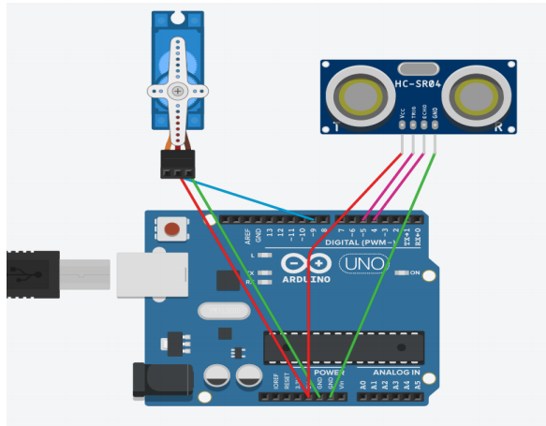
HARDWARE CONNECTIONS

Slide 13
HOME LIGHT AUTOMATION WORKING
In this project,We will set up an automatic lighting system using arduino, so the ideas came when I tried to build automatic lighting system using arduino and PIR motion sensor but I confronted big issue because the light turn ON even if daytime,this is why I thought to use LDR in order to solve this issue.
The main purpose of this project is to prevent loss of current unnecessarily during day time and make the system more efficient then before

Slide 14
Hardware Supplies:
1. Arduino Uno ( any other arduino board will be just fine as long as it provides an Analogical pin ).
2. PIR Motion Sensor
3. LDR (Photoresistor)
4. 10 KOhms resistor
5. Relay module
6. Lamp
7. Breadboard (optional)

Slide 15
CODE
const int ledPin = 13;
const int ldrPin = A1;
void setup()
{Serial.begin(9600);
pinMode(ledPin, OUTPUT);
pinMode(ldrPin, INPUT);}
void loop()
{int ldrStatus = analogRead(ldrPin);
if (ldrStatus <= 500)
{digitalWrite(ledPin, HIGH);
Serial.print("Its DARK, Turn on the LED : ");
Serial.println(ldrStatus);}
else {digitalWrite(ledPin, LOW);
Serial.print("Its BRIGHT, Turn off the LED : ");
Serial.println(ldrStatus);}
}

Slide 16
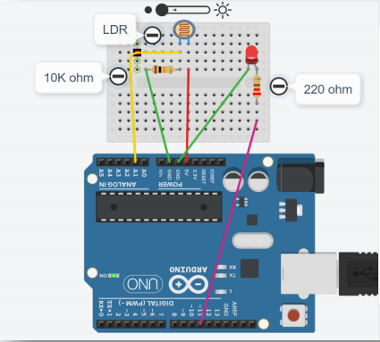
HARDWARE CONNECTIONS

Slide 17
**************************************************
SCOPE & CONCLUSION
In this project, a novel architecture for low cost and flexible home controlling monitoring system using Arudino is proposed and implemented.
This is low power consumer, the power provision can be even through solar panel.
The solar panel can also be used to provide the proper outer look.

Slide 18
THANK YOU

